Slide 1
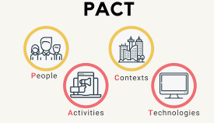
PACT Framework (Chapter 2) Lecture 7-8

Slide 2
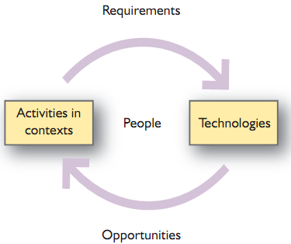
Introduction

Slide 3
PACT Analysis
An analysis based on People, Activities, Context and Technology, well-known by the acronym PACT is a generic framework used to analyze design situations in interactive systems.
PACT analysis follows the principle that "People use Technologies to undertake Activities in Contexts" and covers the scope of Human-Computer Interaction (HCI).
By following this principle, designers understand how each element varies and how all elements affect one another

Slide 4
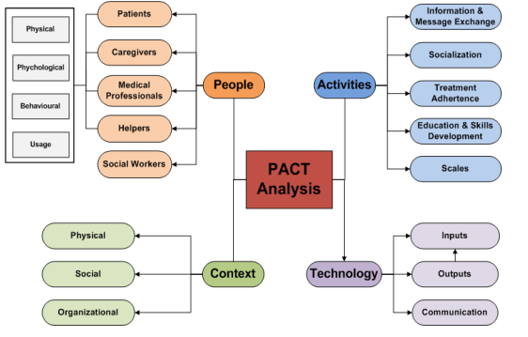

Slide 5
When to Use a PACT Analysis?
In general, a PACT analysis can be proved particularly helpful when the concept is a design solution, especially when analysing a platform design that already exists and needs to be redesigned

Slide 6
People
Physical differences
Height and weight
Variability in the five senses
Ergonomics
Fitts’ law –(Fitts’ Law in HCI (Human–Computer Interaction) is one of those simple-but-powerful rules that explains why some interfaces feel fast and easy while others feel annoying).
Psychological differences
Variety of ways e.g. spatial ability
Language and cultural differences
Individual differences
Psychological tests
Mental models

Slide 7
What Fitts’ Law says
The time it takes for a user to move to a target depends on:
Distance to the target (how far it is)
Size of the target (how big it is)
👉 Closer and bigger targets are faster to click. 👉 Farther and smaller targets take more time and effort.
Simple formula (for understanding)
Movement Time ∝ log₂ (Distance ÷ Target Size)
You don’t need to memorize the formula for beginners—just the idea.
Easy real-life example
It’s easier to hit a big door handle than a tiny button
It’s faster to click a large “Submit” button than a small link far away

Slide 8
Examples in HCI & UI Design
Large buttons on mobile apps (Call, Send, OK)
Edges and corners of the screen (easy to hit because the pointer can’t go past them)
Example: Start Menu in Windows
Toolbar icons placed close to where the user is working
Bigger touch targets for fingers on smartphones
Why Fitts’ Law matters in HCI
Designers use it to:
Reduce user effort - Improve speed and accuracy -Make interfaces usable and user-friendly

Slide 9
Mental models
Mental Models in HCI are all about how users think a system works—not how it actually works under the hood.
People develop mental models through
Interacting with systems
Observing the relationship between their actions and the behaviors of the system
Reading any manuals or other forms of explanation that come with a system.
So, it is important that designers provide sufficient information in the interface (and any accompanying documentation) for people to form an accurate mental mode)
Simple example (everyday)
You think the trash bin deletes files forever → that’s your mental model
In reality, it just moves files to a temporary folder → system model When these don’t match, users get confused

Slide 10
Mental models
Designers have their own conception
It may differ from the actual system
System size and number of designers
System will reveal the designer’s conception.
Users have their own conception
Interact with the system image
A clear, logical and consistent conceptual design
Easier to communicate to people who use the system and hence they will develop a clearer conception of the system themselves.

Slide 11
Mental models
Mental models are incomplete
People can ‘run’ (or try out) their models when required, but often with limited accuracy
Mental models are unstable – people forget details.
Mental models do not have firm boundaries: similar devices and operations get confused with one another.
Mental models are unscientific, exhibiting ‘superstitious’ behavior.
Mental models are parsimonious. People are willing to undertake additional physical operations to minimize mental effort, e.g. people will switch off the device and start again rather than trying to recover from an error.

Slide 12
People
Social Differences
Different reasons/goals/motivations of system usage
Time dependent
Novice and expert users
Discretionary users
Homogeneous VS heterogeneous groups

Slide 13
Activities
Simple to very complex tasks
Main purpose of the task
Temporal aspects
Frequency of the task
Easy to do VS easy to learn
Time pressure
Interruption during the task
Response time
100 milliseconds for hand–eye coordination activities
One second for a cause–effect relationship such as clicking a button and something happening
Anything more than 5 seconds, people will feel frustrated and confused

Slide 14
Activities
Cooperation
Individual VS group task
Awareness, communication, and coordination
Complexity
Well-defined VS vague task
Safety-critical
Serious consequences
Error handling
Nature of content
Text VS video data
Media

Slide 15
Context
Activities always have some context
Surrounding VS multiple activities
Physical environment
Light, noise etc
Social context
Social norms
Organizational context
Power/authority

Slide 16
Technologies
Hardware and software
Large variety of devices
Processing cycle
Input
Buttons – direct method
Mobile phones?
‘QWERTY’ keyboard
Single touch VS multi touch
Remote pointing
Different sensors

Slide 17
Technologies
Output
Mainly different types of screens
Physical dimensions, resolution
Projectors
Printers

